Slide 1

Getting to Zero
…from Board to front line, connecting all the dots!

Slide 2
Beverly Hospital
Addison Gilbert Hospital
Overview
Conceptual frameworks
Key drivers for reducing patient harm
Steps used to implement a successful patient harm reduction program

Slide 3


Beverly Hospital
Addison Gilbert Hospital
Who We Are:
Putting the work in perspective:
4 campuses
300 Medical Surgical, Critical Care, Maternal Child Beds
92 Behavioral Health Beds
64,000 Annual ED Visits
2,600 Staff
800 Providers
815 Nurses

Slide 4
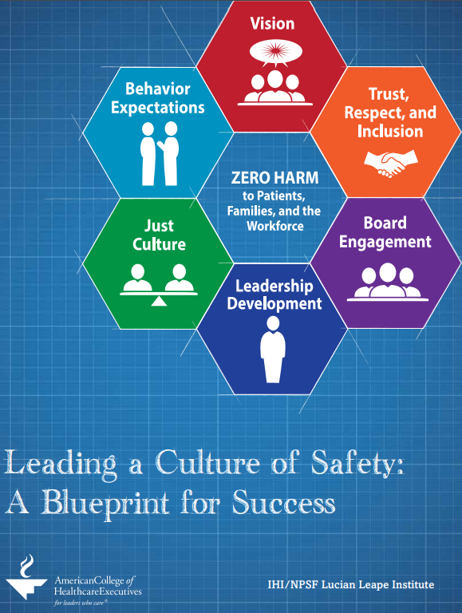
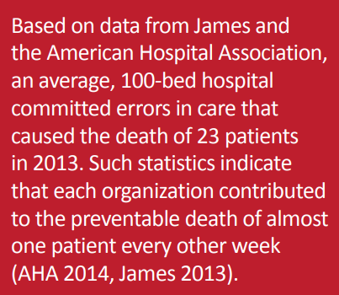
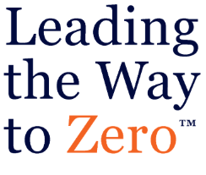

Beverly Hospital
Addison Gilbert Hospital
Why Focus on Zero Harm?
https://www.jointcommission.org/assets/1/23/JC_Online_April_41.PDF
https://cdn.ymaws.com/www.npsf.org/resource/resmgr/lli/Blueprint_Leading_a_Culture_.pdf

Slide 5
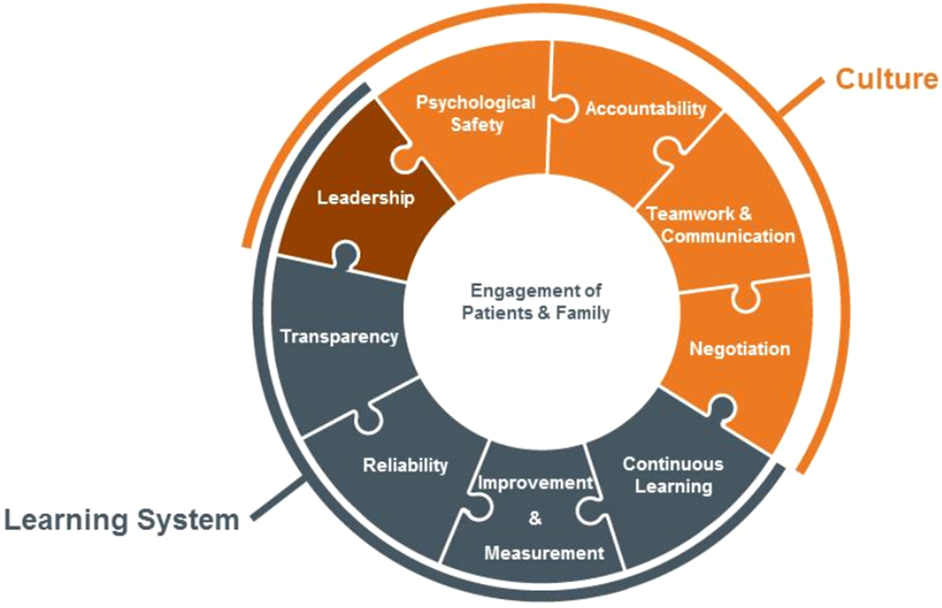
Beverly Hospital
Addison Gilbert Hospital
http://www.ihi.org/resources/Pages/IHIWhitePapers/Framework-Safe-Reliable-Effective-Care.aspx

Slide 6
Beverly Hospital
Addison Gilbert Hospital
Aim
Eliminate all Serious Harm Events
Leadership Engagement
Culture of Safety
Safety Learning System
Harm Reduction Strategies
Partnering with Patients/Families
Colleague Engagement
Primary Drivers

Slide 7

Beverly Hospital
Addison Gilbert Hospital
Leadership Engagement
Leveraging organizational values
c =Community
r =Respect
e =Excellence
a =Accountability
t =Teamwork
e =Empathy
Prioritizing aims

Slide 8
Beverly Hospital
Addison Gilbert Hospital
Leadership Engagement
Examples:
Senior Leadership/Board Safety WalkRounds
      Standard questions; twice a month
      Follow-up and feedback
      Monthly summary to hospital-wide Q&S committee
CREATE Leader Council
      Develop and implement strategies to strengthen and sustain CREATE values
      Monthly

Slide 9
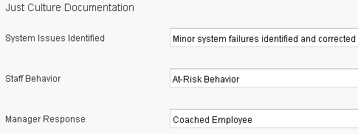
Beverly Hospital
Addison Gilbert Hospital
Culture of Safety
Safety Culture Assessment (survey)
Promote safe reporting
Implement Just Culture approach to event reviews
Professional behavior and teamwork

Slide 10

Beverly Hospital
Addison Gilbert Hospital
Safety Learning System
Safety event reporting platform –
Triage and evaluate events
      RCA/CIR, FMEA, Local PDSA, etc.
Evaluate interventions for intensity and strength of follow-up
Transparency and Communication:
      The Zero
      Daily Game Plan Huddle
      Weekly Safety Huddle
      Annual Safety Fair

Slide 11
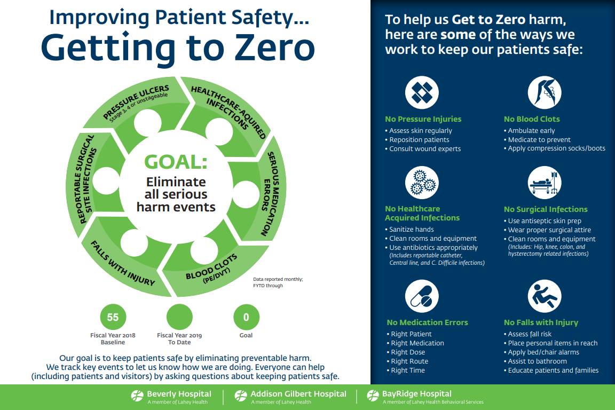
Beverly Hospital
Addison Gilbert Hospital

Slide 12
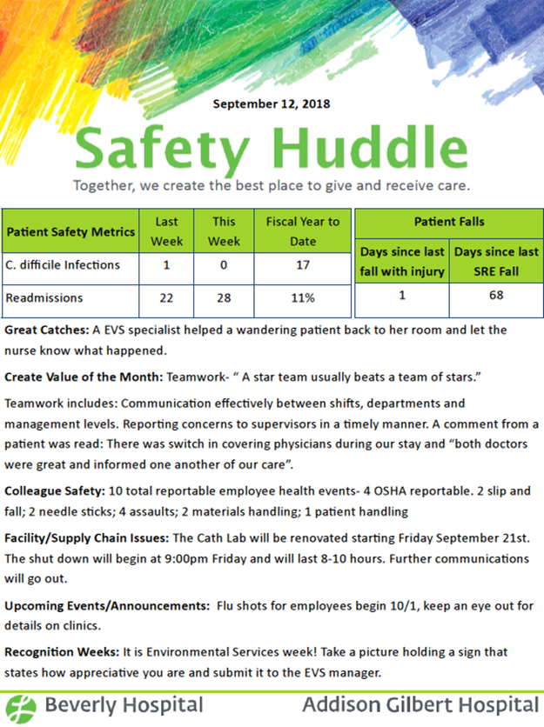
Beverly Hospital
Addison Gilbert Hospital

Slide 13
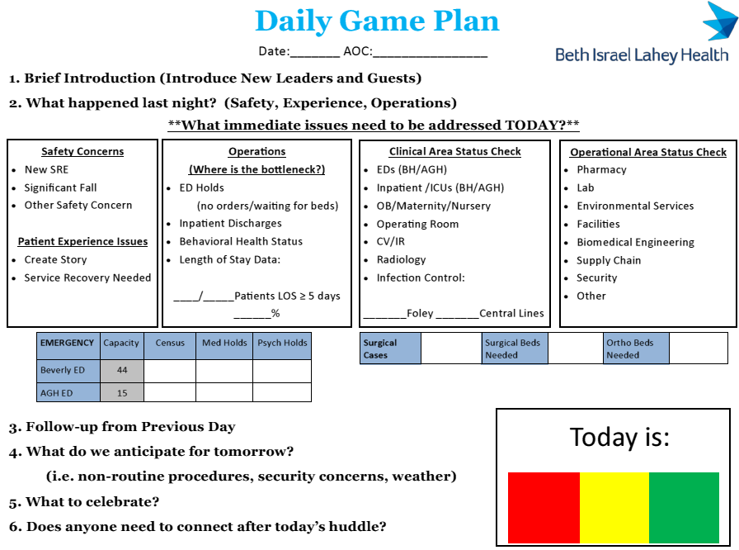
Beverly Hospital
Addison Gilbert Hospital

Slide 14
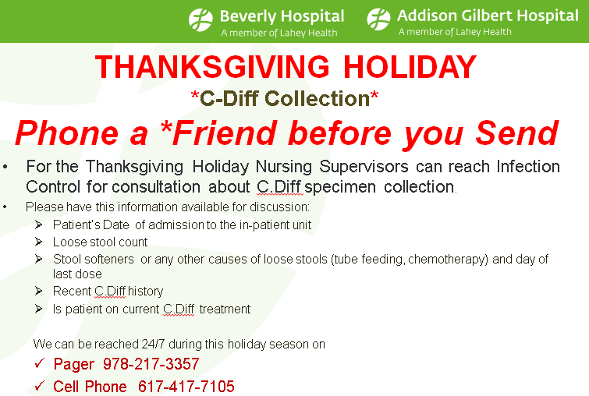
Beverly Hospital
Addison Gilbert Hospital
“Unique” Harm Reduction Strategies
C. diff prevention interventions
Proactive FMEAs
      2-3 completed/yr.
Great catches

Slide 15

Beverly Hospital
Addison Gilbert Hospital
Partnering with Patients/Families
PFAC and Patients on Committees
Admit-to-Discharge (A2D2) Hospital-wide initiative
Bedside Shift Report

Slide 16
Beverly Hospital
Addison Gilbert Hospital
Colleague Engagement
“Front line” participation in improvement efforts and committee
Colleague events to “de-stress”
      “Tea for the Soul”
      Puppy Rx
  Recognition

Slide 17
Beverly Hospital
Addison Gilbert Hospital
FY2018 Results
58% Overall Reduction in Harm Events
C. difficile infections (from 49 to 23; SIR = 0.52)
Falls that meet SRE criteria (from 12 to 6)
Reportable surgical site infections (from 21 to 6)
Serious medication errors (from 4 to 2)
Early elective deliveries (from 1 to 0)
Serious Pressure injuries (remained at 0)

Slide 18
Beverly Hospital
Addison Gilbert Hospital
Further Opportunities
Sustain execution in the face of changing health care landscape
Address compassion fatigue and burnout
Push our transparency comfort zone
Identify the “new frontiers” for engaging patients and families

Slide 19
Beverly Hospital
Addison Gilbert Hospital
Thank You!
Contact Information:
Mark Gendreau
Mark.A.Gendreau@lahey.org
Carol Jones
Carol.S.Jones@lahey.org
Kim Perryman
Kimberly.A.Perryman@lahey.org

